Slide 1
Predicting commodity prices
Predicting Agricultural Commodity Prices using a Deep Learning Approach with Macroeconomic and Climate Data between November 1980 and February 2016
MGT6203. David Basler, Rade Bajic, Nurly Kuzdikbay, Eddie Morrissey, Stijn Jorissen

Slide 2

1
Introduction
Notes:
Justification because of huge influence on daily life

Slide 3
Introduction and business justification
Commodity prices have a big influence on general purchasing power
It is a method of investment
Influences profits in almost all production industries
Notes:
Justification because of huge influence on daily life

Slide 4
Hypotheses
There is a way to predict commodity prices better than ARIMA using state of the art machine learning algorithms
Macroeconomic data and weather will be a factor in the prediction of the prices of commodities
Transformer models can outperform direct models such as LSTM and traditional models such as ARIMA
Notes:
Explanation of why this hypothesis is chosen

Slide 5
2
Data description
Notes:
Justification because of huge influence on daily life

Slide 6
Data description
Commodity prices dataset
Consists of the monthly prices of 53 commodities from 1980 to 2016, primarily US indexes,
US weather data:
Consists of monthly average temperatures in all US states from 1950 to 2022,
Specific states average precipitation per month,
US macroeconomic data:
Inflation, NASDAQ index, mortgage rates, unemployment, disposable income, personal consumption, personal savings from 1980 to 2022,
Notes:
Regarding the data, we leveraged multiple datasets, each serving a distinct purpose and aiding in the formation of a our analysis.
First, we have the Commodity Prices Dataset, obtained from Kaggle. This dataset encapsulates the chronological evolution of the prices for 53 different commodities, tracked on a monthly basis from the year 1980 through 2016. Predominantly, these are US indexes, providing us a granular view into the dynamics of the commodity market over this period of time.
The second dataset pertains to US weather data, sourced from the National Oceanic and Atmospheric Administration, or NOAA. This dataset furnishes monthly average temperatures across all US states, spanning an even broader time frame - from 1950 to 2022. Supplementing this, it also includes data on average precipitation per month, specifically for select states, providing us a dual perspective on the weather patterns.
Finally, we incorporated a US Macroeconomic Data set, also sourced from Kaggle. This dataset proffers a plethora of economic indicators, including but not limited to, inflation rates, the NASDAQ index, mortgage rates, unemployment rates, disposable income, personal consumption, and personal savings. The timespan coverage for these indicators mirrors the Commodity Prices dataset, that is from 1980 to 2022.
In summary, these datasets collectively offer a rich, multi-faceted view into the interplay of economic, meteorological, and commodity price data over substantial periods of time, thereby enabling a comprehensive analysis for our project.

Slide 7
3
Data cleaning
Notes:
Justification because of huge influence on daily life

Slide 8
Data cleaning and preparation
Data cleansing and merging three datasets (US commodity prices, US macroeconomic data, and US weather data).
Alternative weather dataset.
Monthly data from November 1980 to February 2016
Time-series format (ts or xts/zoo).

Slide 9
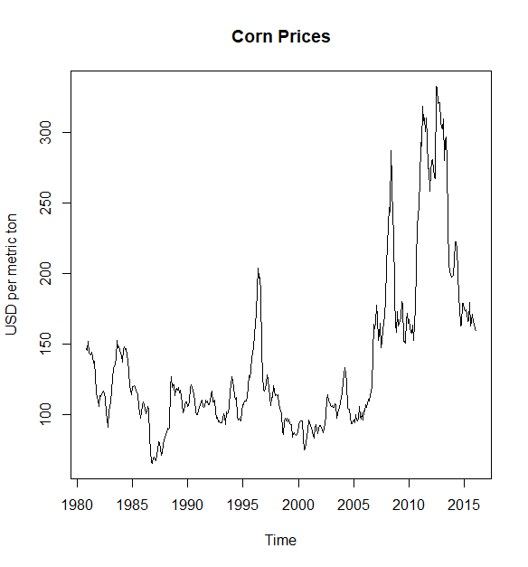
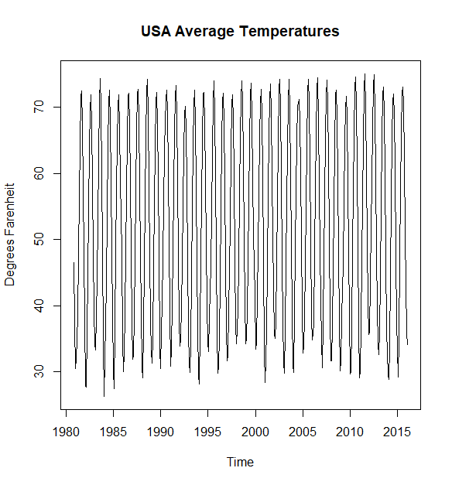
Inspection of Corn Prices
No specific pattern in corn prices.
Lack of seasonality compared to average temperatures.
Increase in corn prices with changing variability.
Higher volatility during the 2008 financial crisis.

Slide 10
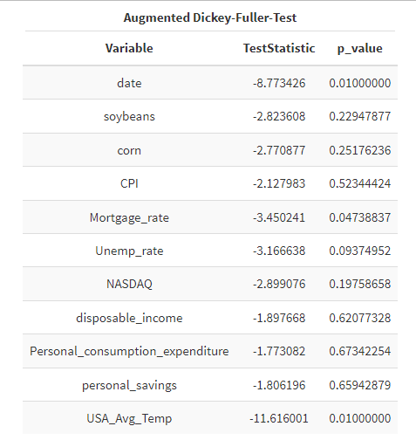
Test for Stationarity and Transforming time series
Stationarity:
Augmented Dickey-Fuller-Test (ADF) with a p-value of 0.05.
Most variables were non-stationary, but Mortgage Rate and USA Average Temperatures were stationary.
Time series:
Non-stationary variables to stationary.
First differences of the logarithmized series for the respective variables.
Ensured absence of negative or NULL values.
Corn prices: removing trends, seasonality, and stabilizing variance.

Slide 11
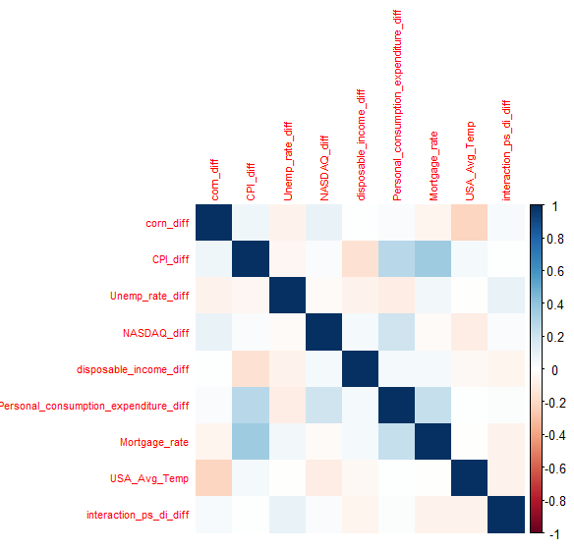
Test for Causality
Causality:
Correlations within macroeconomic variables
Interaction terms to capture joint effects
Dropped original variables to eliminate multicollinearity
Granger Causality results
Statistically significant correlations between predictor and predicted variables.
Correlations tested with various lags.
Corn prices affected by temperature in Illinois, CPI difference, mortgage rate, and more.

Slide 12
4
Data modeling
Notes:
Justification because of huge influence on daily life

Slide 13
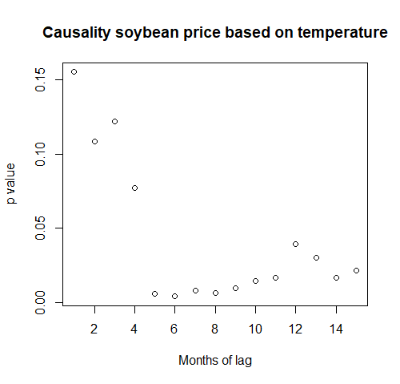
Modelling techniques used
Feature selection:
Based on the results from the Granger Causality Test
We limited the selection to the three most important features
Example for corn price prediction: USA average temperatures, consumer price index, interaction term personal savings * disposable income
Data split:
48 months as test set
Evaluation metrics:
Mean Absolute Percentage Error (MAPE) → relative measure of prediction difference
Root Mean Squared Error (RMSE) → absolute measure of prediction difference
R-Squared (R2) → ranges from 0-1, where higher values indicate better fit
Confusion matrix
Notes:
Short description of each model type

Slide 14
Modelling techniques used
Selected prediction models:
AutoRegressive Integrated Moving Average (ARIMA)
Classical and widely used forecasting model (baseline)
Is effective for stationary time series data
Silverkite
Advanced forecasting model that is designed to handle complex time series data
Capable of automatically identifying and capturing patterns, making it highly adaptive
Recurrent neural network (RNN)
Deep learning model that utilizes feedback loops to maintain internal states, allowing to remember past information while processing new data points
Useful for sequential data where previous observations influence future predictions
Long short term memory network (LSTM)
Advanced type of the RNN that introduces specialized memory cells that selectively retain or forget information.
Useful when dealing with time series data with complex patterns and lengthy temporal dependencies
Temporal fusion transformers model (TFT)
Advanced and state-of-the-art forecasting model that combines the power of transformers and temporal fusion techniques
Useful for tasks that involve complex temporal patterns, long-range dependencies, and multi-horizon predictions.
Notes:
Short description of each model type

Slide 15
5
Empirical results
Notes:
Justification because of huge influence on daily life

Slide 16
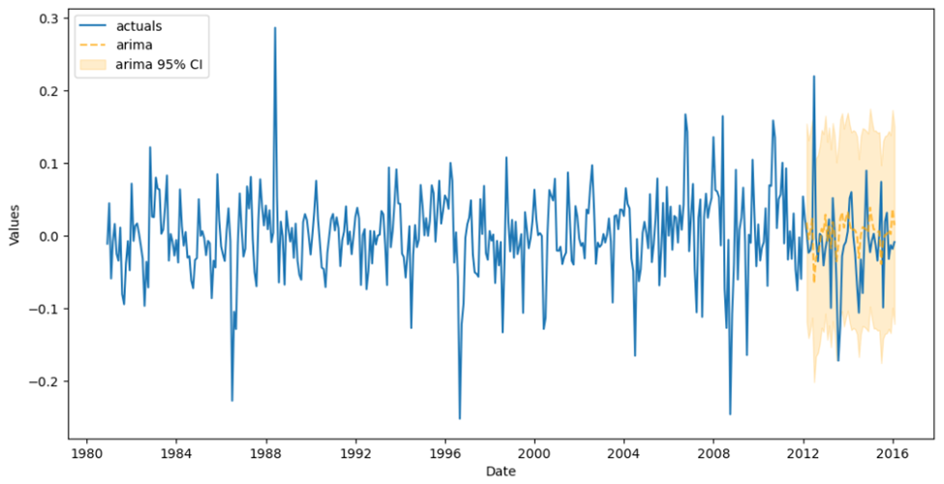
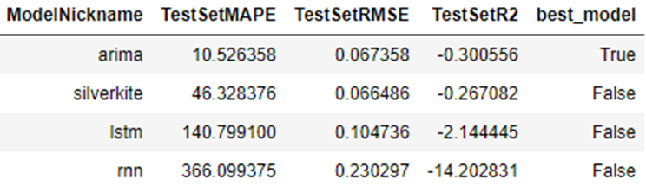
Corn price prediction results (1/2)
Model comparison (after hyperparameter tuning)
MAPE → ARIMA
RMSE → Silverkite
R2 → ARIMA
The best model was ARIMA, but…..

Slide 17
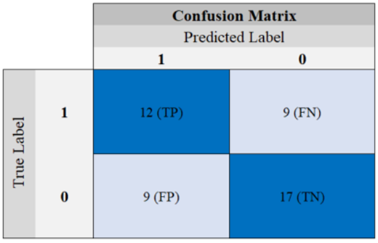
Corn price prediction results (2/2)
Thinking about business justification:
No model would be useful
But, trades value a price direction engine
Alternative approach:
Checking if a model was able to predict in the right direction
Silverkite showed the best performance with an accuracy of 62%

Slide 18
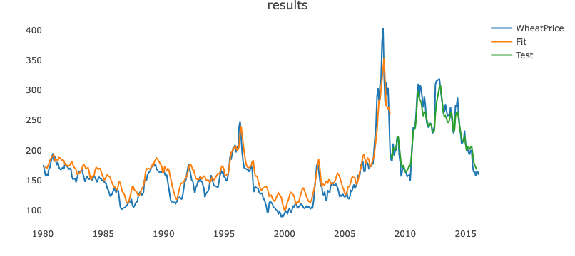
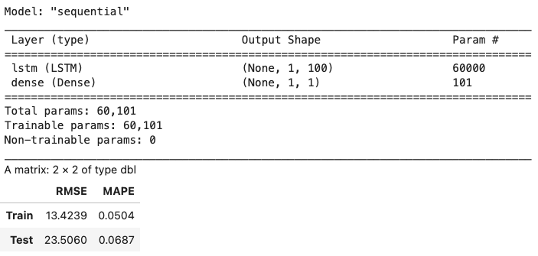
Wheat price prediction results
Wheat price seem to be forcastable by both own historical values and in correlation with the temperature data from farming locations (states) in the US., with following observations:
Values obtained by forecast seem to be best at shorter prediction intervals, while long term one were not satisfactory i.e. close to 50% accuracy.
Best prediction results were achieved by LSTM model, which managed to forecast with 0.08 MAPE.
TFT model did not show good results, however, was reacting positively to adding of temperature data as “known” variable, indicating sensibility to detection of that correlation. Computation resource was hard constraint.
Potential of short term prediction is justifying further investigations on identifying additional predictors which might help mid-horizon (month+) predictions accuracy, as we suspect that such horizons might be of a highest interest to both business and government sectors.
LSTM

Slide 19
Conclusion
ARIMA models are very competitive compared to the other models
Silverkite showed the best abilities to predict price directions of corn prices
LSTM showed potential for short-term horizon forecasting
Transformer model did not justify “state of the art” status, while being very computationally demanding
Notes:
Try to answer the questions from the hypothesis here

Slide 20
6
Appendix
Notes:
Justification because of huge influence on daily life

Slide 21
Literature review
Modelling Inflation Dynamics: A Critical Review of Recent Research
Can you predict commodity stocks using a weather forecast? by I. Colbert Medium
Climate and environmental data contribute to the prediction of grain commodity prices using deep learning
Price forecasting and evaluation: An application in agriculture. By Jon A. Brandt, David A. Bessler

Slide 22
Granger Causality Results
Predictor | Predicted | Lowest found p value | Lag for lowest found p value (months)
Temperature in Kansas | US wheat prices | 0.21 | 3
Precipitation in Kansas | US wheat prices | 0.57 | 1
Temperature in New York | US LNG prices | 0.10 | 13
Temperature in New York | US energy price index | 0.01* | 1
Temperature in Illinois | US soybean price | 0.006* | 6
Precipitation in Illinois | US soybean price | 0.41 | 3
CPI difference | Corn price | 0.036* | 1
Unemployment rate | Corn price | 0.665 | 1
Nasdaq difference | Corn price | 0.331 | 1
Disposable income difference | Corn price | 0.174 | 1
Average US temperature | Corn price | 0* | 1
Mortgage rate | Corn price | 0.045* | 6
Interaction PS difference | Corn price | 0.033* | 6
Statistically significant correlations between predictor and predicted variables.
Correlations tested with various lags.
Corn prices affected by temperature in Illinois, CPI difference, mortgage rate, and more.

Slide 23
Test for Causality
Causality:
Correlations within macroeconomic variables
Interaction terms to capture joint effects
Dropped original variables to eliminate multicollinearity
Stationarity:
Augmented Dickey-Fuller-Test (ADF) with a p-value of 0.05.
Most variables were non-stationary, but Mortgage Rate and USA Average Temperatures were stationary.

Slide 24
Long Short-Term Memory (LSTM) Models
LSTM models were created to predict US wheat prices on basis of past prices and on basis of past prices + monthly temperatures in wheat-producing US states.
Point-by-point prediction model, showed promising results, by using both only historical price data and mix of his.price data and temperature data.
However, longer horizon model, utilizing similar hyperparameters setup yielded completely different results.
The above point to the lack of long-term dependencies or inability of LSTM to capture the ones from data used.

Slide 25
Temporal Fusion Transformer (TFT) Model
Following current state of machine learning research and applications, we have looked into transformers as being designated as “state of the art”. Thus, we have applied temporal version of transformer model in aim to produce multivariate, multi-horizon forecast, utilizing several types of variables. The results yielded mid-level precision, in comparison to other models with following remarks:
Several optimization attempted were utilized, in particular by searching for optimal learning rate by starting from very low value and stepwise increasing it while recording the loss - in order to plot lr vs loss and graphically identify the optimal learning rate.
Multiple status of look-back duration, total forecast horizon, epochs and number layers were manually tested.
The model is incredibly computation-heavy (we have utilized 16-CPU cloud-based machine and have resulted with average time of 6 minutes / epoch of training time with 8 hidden layers + 1 attention + 1 lstm layer setup.

Slide 26
Further ARIMA models
ARIMA models were used to predict:
US fuel price index based on temperature in New York
Soybean prices based on temperature in Kansas
Error values dropped a little compared to models without trending factors
Trending factors were low
So low they are more likely to be insignificant on the long term
Trending factors had counter intuitive influence

